Slide 1
DTTF/NB479: Dszquphsbqiz Day 28
Announcements:
  Choosing presentation dates (at end)
Questions?
This week:
  Hash functions, SHA
  Birthday attacks
  Digital signatures (Monday)

Slide 2
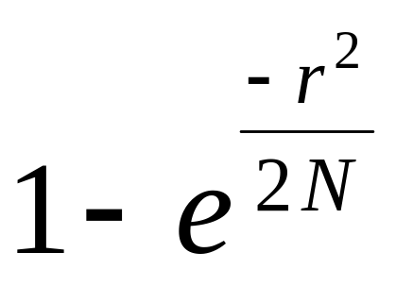
Birthday paradox
1-2
What are the chances that two people in our class have the same birthday?
Exact solution: use fractions
Approximate solution:
Where r = 26 people, and N = 365 choices

Slide 3
The birthday paradox doesn’t mean that there’s a high probability that someone else has my birthday
3
What’s the chance that one of the other students has your birthday?
Note: the chance of someone matching me is low, but there are lots of ways to get pairs of matches in general.

Slide 4
Likewise, the birthday paradox doesn’t mean that finding a collision with a known digest is easy
4
What’s the chance that one of the other students has your birthday?
Key: the chance of someone matching me is low, but there are lots of ways to get pairs of matches in general.
  Strongly collision-free: Can’t find any pair m₁ ≠ m₂ such that h(m₁)=h(m₂) easily
  (Sometimes we can settle for weakly collision-free: given m, can’t find m’ ≠ m with h(m) = h(m’).

Slide 5
We can calculate how many messages we need to hash to have a good chance of finding a collision
5
How many people are needed to get the probability of having 2 with the same birthday to be above 50%?
Derive for general N (not just days in a year)

Slide 6
Birthday attacks on SHA-1?
6
How many digests are possible when h is an n-bit hash? This is N.
The birthday paradox says I can choose r = sqrt(n) messages and there’s a good possibility that 2 will match.
  For a 60-bit hash, r = ???
  For a 160-bit hash, r = ???

Slide 7
Multicollisions are harder to find, but not as hard as expected.
What if instead of finding a just pair of collisions, we need to find 8 collisions?

Slide 8
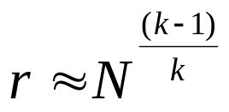
Multicollisions
7
Recall: given r people and N (say, 365) birthdays. If , then there’s a good chance that 2 people will have the same birthday
Generalization: given r people and N birthdays. If
for some k, then there’s a good chance that k people will have the same birthday.
So for 160-bit hashes, how many messages do we need to generate to get an 8-collision?
That’s lots more than 2⁸⁰!
However, there’s a big underlying assumption: the hash function is random!
Is SHA-1 random? (answer on next slide)

Slide 9
No
(It’s iterative…)

Slide 10
Recall this picture
8
m₁’
m₁
m₂’
m₂
m₃’
m₃
m_{L}
h’
h’
h’
h’
X₀
X₁
X₂
X₃
X_{L}
=h(m)
Consider the following attack:
Birthday attack the first block: x1 = h’(x0, m1)
  Need to generate 2^{n/2} messages
  Result: found (m1, m1’) such that x1 = h’(x0, m1) = h’(x0, m1’)
Repeat for x2 and x3, finding pairs (m2, m2’) based on x1 and (m3, m3’) based on x2.
  Need to generate total of 3 * 2^{n/2} messages
  Result: found 8 combinations (m1, m1’) x (m2, m2’) x (m3, m3’) with same x3.
3 x 2⁸⁰ is lots smaller than 2¹⁴⁰.
Notes:
Generalizes: get a 2^t multicollision with only t * 2^(n/2) messages.

Slide 11
Birthday attacks on discrete logs
Compare with BabyStep, GiantStep attack
Birthday attack
  Uses sqrt(n) modular exponentiations
  Works probabilistically
  Works with high probability.
  Requires random modular exponentiations to be done
BabyStep, GiantStep attack
  Uses sqrt(n) modular exponentiations
  Works deterministically.
  Guaranteed to work
  Does modular exponentiations in order, which is somewhat faster

Slide 12
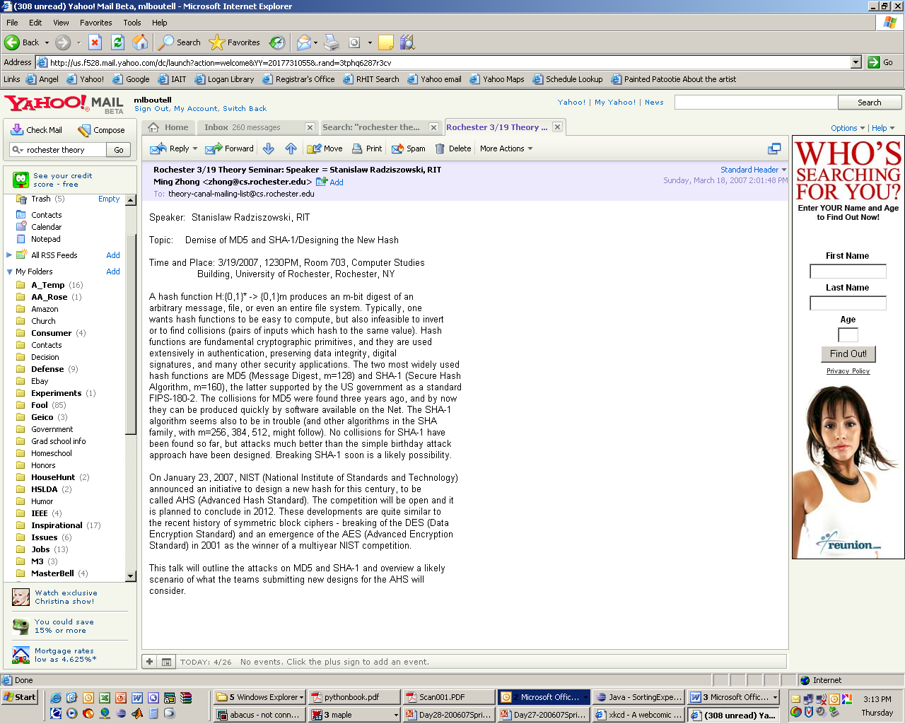
The Future of SHA-1?

Slide 13
The best attack so far…
On 17 August 2005, an improvement on the SHA-1 attack was announced on behalf of Xiaoyun Wang, Andrew Yao and Frances Yao at the CRYPTO 2005 rump session, lowering the complexity required for finding a collision in SHA-1 to 2⁶³.
Notes:
Used in 2009, but I think it was proven false: A potential big improvement: 2⁵² combinations for a collision:
http://awurl.com/dXeyWi5fn (broken link) Presented last Tuesday. Thanks to Michael Mrozek for catching this.

Slide 14
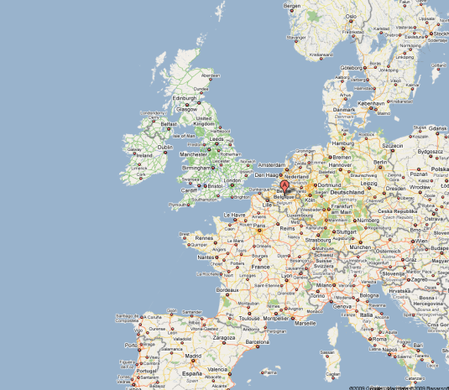
SHA-3 Under evaluation by NIST
Candidate submissions due Oct. 31, 2008
  Received 64 (51 complete, currently down to 40)
  From US, Canada, China, Singapore, Japan, Korea, Argentina, India, Switzerland, Macedonia, Turkey, Israel, Belgium, France, Norway, Luxembourg and a number of “pan European” submissions
199 cryptographers met in February 2009 at KU Leuven, Belgium
  Open discussion
  Cryptanalysis is hard!
  Got it cut down to 5 finalists
  Michael Pridal-LoPiccolo’s senior thesis is on Keccak
www.ietf.org/proceedings/09mar/slides/saag-0.ppt
http://csrc.nist.gov/groups/ST/hash/statement.html

Slide 15
SHA-3 is not yet standardized
2007: SHA-3 competition announced
2009: 51 submissions cut down to 5
2011: 5 finalists under evaluation
  Michael Pridal-LoPiccolo (’11) studied Keccak for senior thesis
2013: Keccak chosen!
Latest on SHA-3:
http://www.nist.gov/itl/csd/sha-100212.cfm

Slide 16
For your pleasure…
9-12
What’s the chance that 2 people in a family of 4 have a birthday in the same month?
How big does our class need to be to have:
  a 99% chance that 2 have the same birthday?
  a 100% probability (guaranteed) that 2 have the same birthday?
Trivia: If a professor posts grades for his class by using the last 4 digits of each student’s SSN, what’s the probability that at least 2 students have same last 4 digits?
…for a class at UIUC? (200 students)
…for a class at Rose? (30 students)

